Slide 1
Overview

Slide 2
What were the results of the ASPIRE study?
Overall, the ASPIRE study (MTN-020) showed that the dapivirine vaginal ring prevented approximately one third of HIV infections.
Notes:
Among women older than 21, who used the ring more consistently than younger women, more than half of HIV infections were prevented. In ASPIRE, even greater protection was seen with higher adherence (more than two thirds).

Slide 3
What were the results of the ASPIRE study?
Like other prevention methods, the ring only works if used correctly and consistently. The ring was also safe, meaning that it did not cause significant health problems.
Notes:
Another study that tested the dapivirine vaginal ring, called IPM-027 (The Ring Study), showed similar results.

Slide 4
This is a tremendous success that would not have been possible without the commitment of our study participants!
What were the results of the ASPIRE study?

Slide 5
When will the dapivirine vaginal ring be available in our communities?
IPM, the group that developed the ring, is working with governments and other partners with the goal of making the ring available in our communities.
Notes:
This process involves many regulatory and country-specific approvals and each one takes time.

Slide 6
Why is the HOPE study being done?
HOPE is an Open-Label Extension (OLE) study, designed to offer participants access to an effective study product before it is available in the community.
Notes:
Open-Label Extension studies are also conducted to collect additional information about the product, like about safety and adherence.

Slide 7
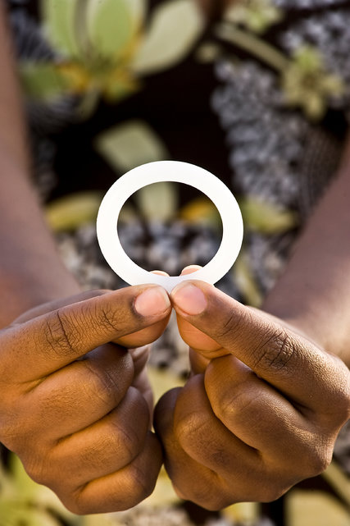
The primary purpose of the HOPE study is to offer participants immediate access to the dapivirine vaginal ring, which has been shown to be safe and to decrease the risk of getting HIV.
Why is the HOPE study being done?

Slide 8
Who is eligible for the HOPE study?
Currently, only women who participated in the ASPIRE study will be considered for enrollment into HOPE.
Women must understand the study requirements, and agree to take part.

Slide 9
Who is eligible for the HOPE study?
Women must be in good health, HIV negative, and not be pregnant or breastfeeding. Women will have medical tests and exams to confirm that they are eligible for HOPE.

Slide 10
How long is the study? How often are study visits?
Each woman who enrolls will be in HOPE for about 1 year.
Study visits will be monthly for the first three months, and then once every three months after that.
Notes:
Open-Label Extension studies are also conducted to collect additional information about the product, like about safety and adherence.

Slide 11
What are the vaginal rings like in HOPE?
All women will be offered a vaginal ring containing dapivirine for monthly use.
Notes:
Unlike ASPIRE, there are NO placebo rings (without medication) in HOPE.

Slide 12
What will women who enroll in HOPE be asked to do?
All eligible participants will be invited to join HOPE and attend regularly scheduled study visits.

Slide 13
What will women who enroll in HOPE be asked to do?
All participants will be offered the dapivirine vaginal ring to use monthly.
Women can join the study regardless of whether they choose the ring as an HIV prevention method or not.

Slide 14
What will women who enroll in HOPE be asked to do?
Women who choose the ring as an HIV prevention method will receive counseling and instructions about ring use and will be asked to answer questions about ring use.

Slide 15
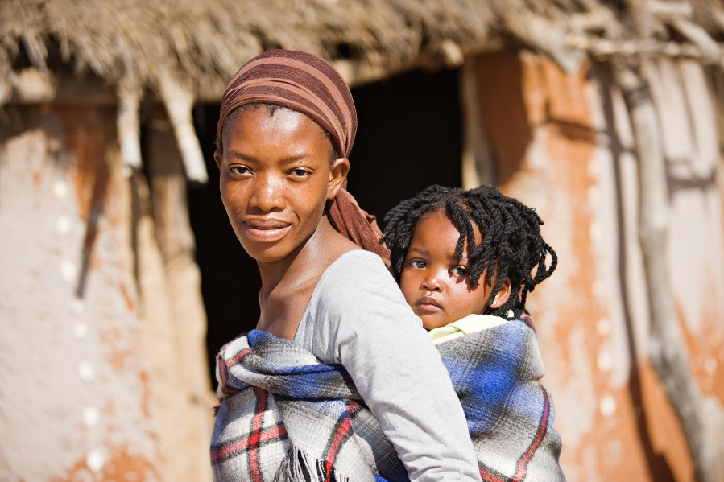
What will women who enroll in HOPE be asked to do?
Participants can change their mind about using a ring even after joining the study.
Remember, though, that the ring can only protect against HIV when it is used.
Notes:
All participants make important contributions to the study as long as they tell study staff when they are not using the ring.

Slide 16
All participants, regardless of ring use, will be asked to:
Answer questions about their health and sexual behaviors
Receive risk reduction counseling and condoms
Use a family planning method to prevent pregnancy

Slide 17
At some visits, have health examinations
Have laboratory tests, including tests for STIs, pregnancy, and HIV
Provide blood, hair, and vaginal swab samples
All participants, regardless of ring use, will be asked to:

Slide 18
What about women who decline enrolment into HOPE?
If a participant decides she does not want to enroll in HOPE, she will be asked if she is willing to have one visit to provide information about why she is declining enrollment.

Slide 19
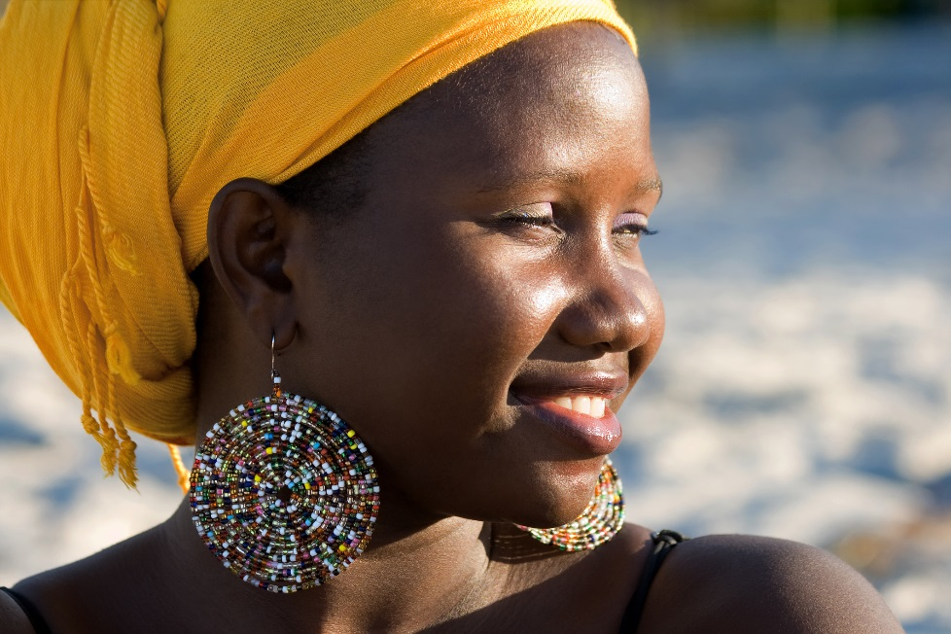
What about women who decline enrolment into HOPE?
Participants who decline enrollment may change their mind and enroll in HOPE, provided that the study is still ongoing and they meet eligibility requirements.

Slide 20
What are the risks?
The risks of participating in HOPE are similar to ASPIRE:
You may feel discomfort or pain from the exams or blood draws.
The vaginal ring may feel uncomfortable to some women, and some may have itching, discharge, or other symptoms.

Slide 21
What are the risks?
You may be embarrassed by questions and procedures in the study.
It is possible that you or your partner may feel the ring during sexual activity.

Slide 22
What are the risks?
In the unlikely event you become infected with HIV, you may develop drug resistance if you continue to use the ring.
It is possible that others may treat you unfairly or discriminate against you for participating in the study.

Slide 23
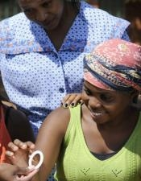
What are the benefits?
During study participation, women in HOPE will be offered access to a vaginal ring that has been found to be safe and effective for HIV prevention.

Slide 24
What are the benefits?
Women in the study will also receive medical exams, tests to check on their health, family planning, HIV/STI counselling and testing, and treatment or referrals, as needed.

Slide 25
What can partners and community members do?
For women who are eligible, deciding whether to join HOPE and whether to use the ring is an individual choice. Women are encouraged to discuss their decision with their partners and other people who are important to them.
Notes:
Study staff will keep information about women in the study confidential, but are also available to talk about HOPE and answer any questions partners or community members have, as needed. By being supportive, partners and community members are also helping to fight HIV/AIDS.

Slide 26
If you have questions or need more information, please visit the study clinic.

